Slide 1
Finite Automata
Chapter-2 (Part-3)

Slide 2
DFA
For input string: bababaa
S₀ S₀ S₁ S₀ S₁ S₀ S₁ S₁
b
a
Start
a
S₀
S₁
b
b
a
b
a
b
a
a

Slide 3
NFA
For input string: bababaa
S₀ S₀ S₀ S₀ S₀ S₀ S₀ S₀
S₁ (stuck) S₁ (stuck) S₁ (stuck) S₁ (Accepted)
a,b
Start
a
S₀
S₁
b
a
b
a
b
a
a
a
a
a
a

Slide 4
DFA vs NFA
DFA: {S₀,a}={S₁}
NFA:
{S₀,a}={S₀}
{S₀,a}={S₁}
{S₀,a}={S₀,S₁}
{S₀,a}=ɸ
So, {S₀,a}={{S₀} , {S₁}, {S₀,S₁}, ɸ}
That is, when number of states is 2, there are 2² states possible for a given input symbol
Similarly, when number of states is 3, there are 2³ states possible for a given input symbol
{S₀,a}={{S₀} , {S₁}, {S₂}, {S₀,S₁}, {S₀,S₂}, {S₁,S₂}, {S₀,S₁, S₂}, ɸ}

Slide 5
DFA vs NFA
Number of possible states for an input symbol:
DFA: Q x Ʃ→ Q
NFA: Q x Ʃ→ 2^{Q}

Slide 6
Nondeterministic Finite Automata (NFA)
A nondeterministic finite automaton has the ability to be in several states at once.
Transitions from a state on an input symbol can be to any set of states.

Slide 7
NFA (contd…)
An NFA is represented as follows:
A=(Q, Σ, δ, q₀, F)
where
Q is a finite set of states.
Σ is a finite set of input symbols.
q₀, a member of Q, is the start state.
F, a subset of Q (F ⊆ Q), is the set of final states.
“Final” and “accepting” are synonyms.
A transition function (δ, typically) is a function that takes a state in Q and an input symbol in Σ as arguments and returns a subset of Q.

Slide 8
Difference between DFA and NFA
The only difference between an NFA and a DFA is in the type of value that δ returns:
A set of zero, one, or more states in the case of an NFA, and
A single state in the case of a DFA.

Slide 9
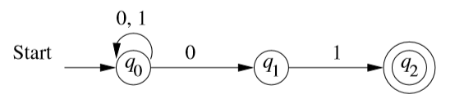
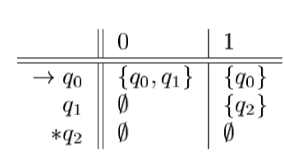

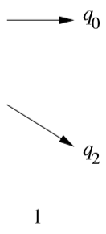
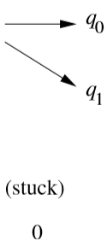
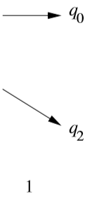
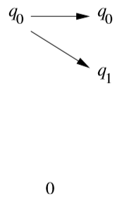
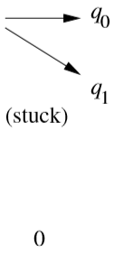
More about NFA
NFA can be described as follows:
Transition Table ->
Processing an NFA for
The string 00101:
As the automaton is at final state,
The string 00101 is accepted for
The NFA.

Slide 10
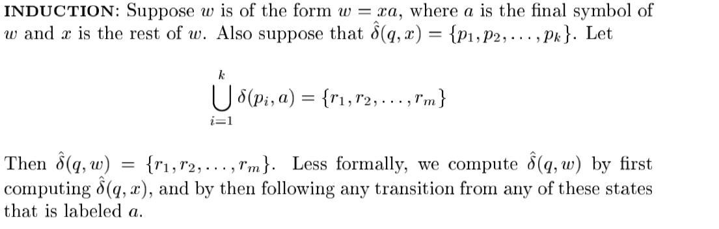
Extended Transition Function for an NFA

Slide 11

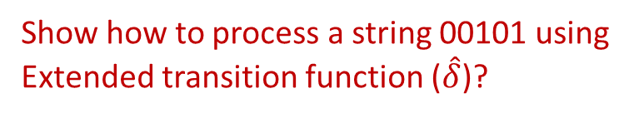
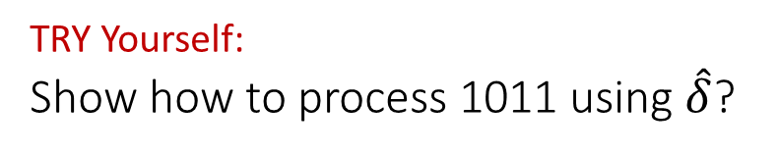
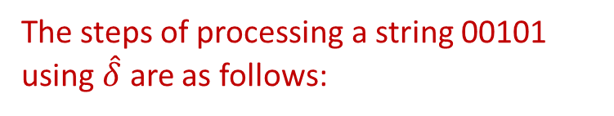
Extended Transition Function for an NFA (contd…)
The steps of processing a string 00101 using $\hat{δ}$ are as follows:
Show how to process a string 00101 using
Extended transition function ($\hat{δ}$)?
TRY Yourself:
Show how to process 1011 using $\hat{δ}$?
As the NFA is at q₀ and q₂ states after processing the given string and q₂ is a final state of the NFA, the string is accepted for the NFA.

Slide 12
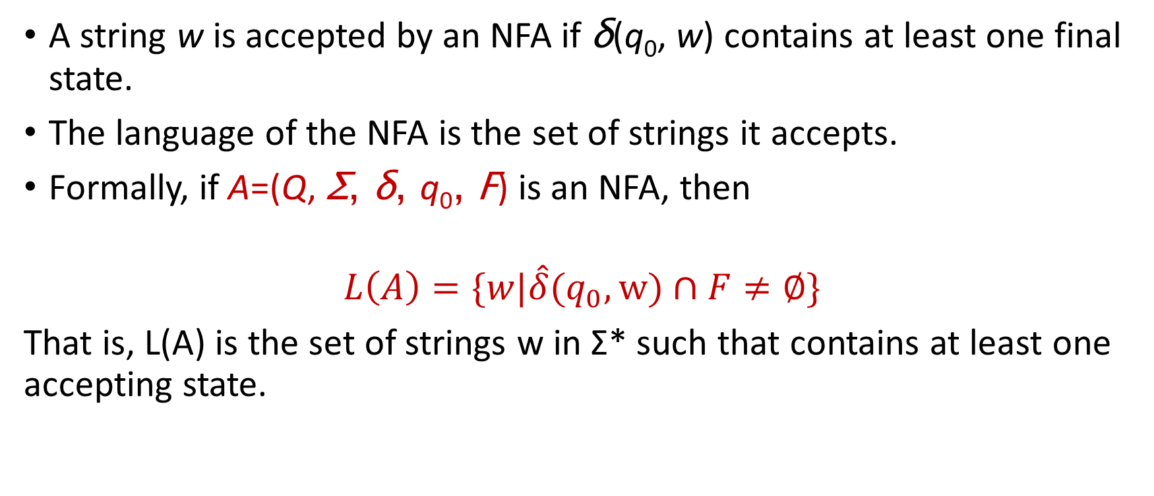
Language of an NFA
A string w is accepted by an NFA if δ(q₀, w) contains at least one final state.
The language of the NFA is the set of strings it accepts.
Formally, if A=(Q, Σ, δ, q₀, F) is an NFA, then
$$L\left(A\right)=\{w|\hat{δ}(q_{0},w)∩F≠∅\}$$
That is, L(A) is the set of strings w in Σ* such that contains at least one accepting state.

Slide 13
Equivalence of DFA and NFA
A DFA can be turned into an NFA that accepts the same language.
If δ_{D}(q, a) = p, let the NFA have δ_{N}(q, a) = {p}.
Then the NFA is always in a set containing exactly one state – the state the DFA is in after reading the same input.

Slide 14
Equivalence of DFA and NFA (cont’d)
Surprisingly, for any NFA there is a DFA that accepts the same language.
Proof is the subset construction.
The number of states of the DFA can be exponential in the number of states of the NFA.
Thus, NFA’s accept exactly the regular languages.

Slide 15
Subset Construction
Given an NFA with states Q, inputs Σ, transition function δ_{N}, state state q₀, and final states F, construct equivalent DFA with:
States 2^{Q} (Set of subsets of Q).
Inputs Σ.
Start state {q₀}.
Final states = all those with a member of F.

Slide 16
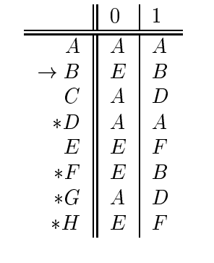
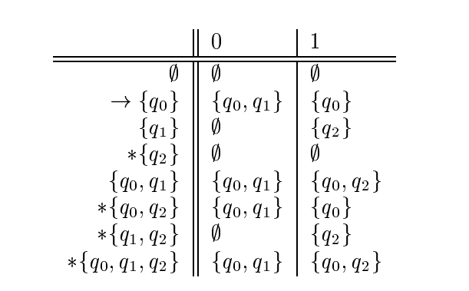
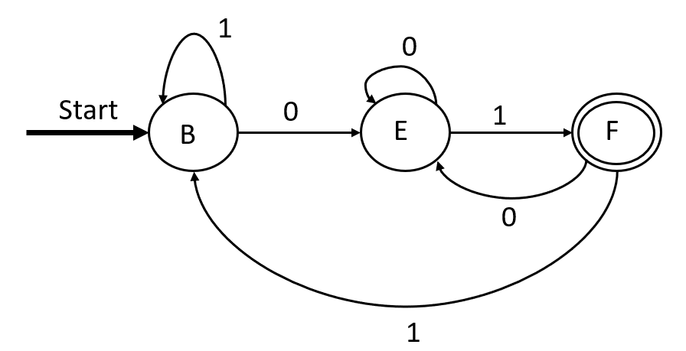
Example
NFA
Renaming the states
Renaming the states
Number of States in DFA=2³
The Complete Subset
Construction
DFA

Slide 17
SELF STUDY
Theorem 2.11 and 2.12
Solve relevant exercises

Slide 18
? Questions

